Slide 1

Team Ovulife
SLiCE(Shared Live Client Experience)
PROJECT
PRESENTATION

Slide 2

SLiCE(Shared Live Client Experience)
PROJECT
PRESENTATION
Team Ovulife

Slide 3
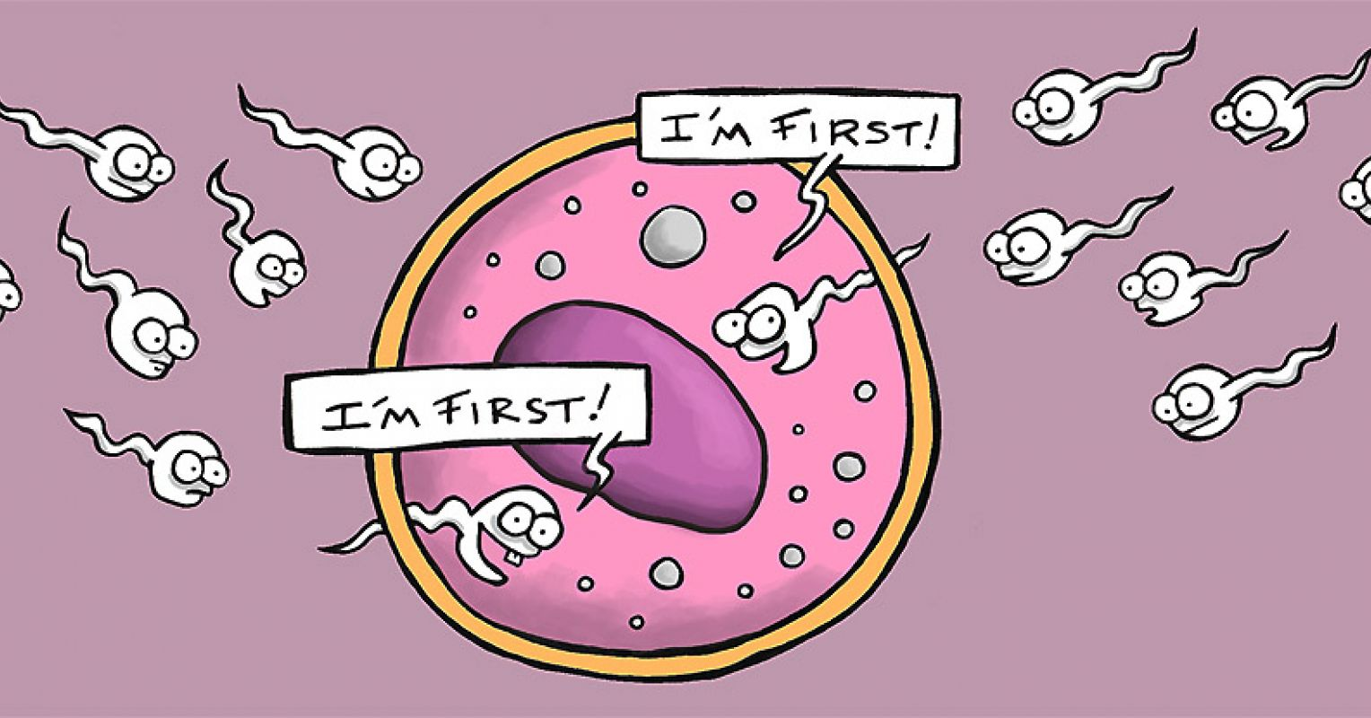
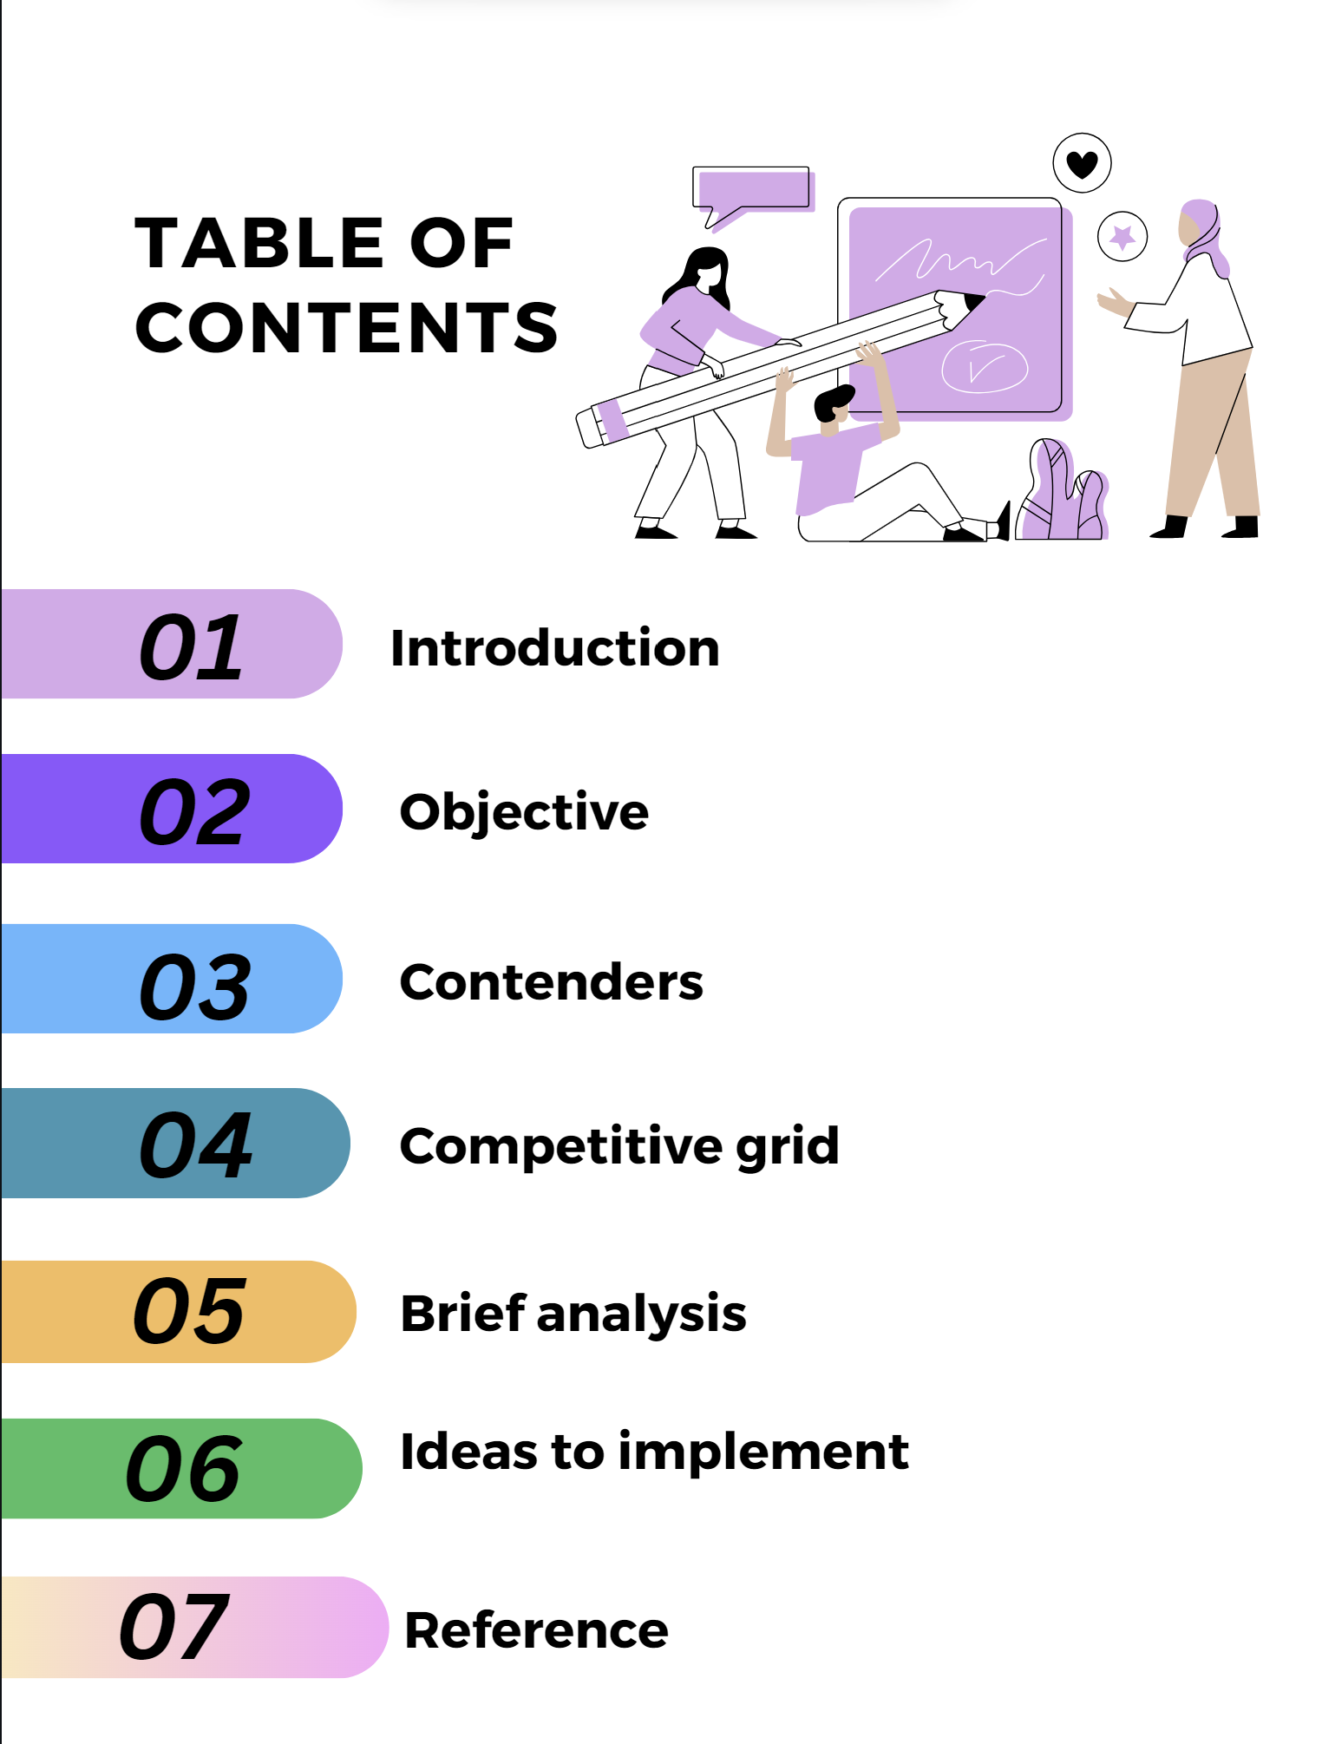
Team Ovulife

Slide 4






Meet The Team
Al Aftab Mohammad Shaik
Rajini Ramisetti
Rakesh Velaga
Abdul Khalid
Somesh Katakam
Team Ovulife

Slide 5
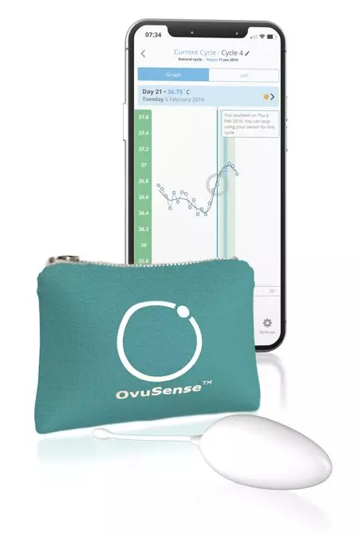
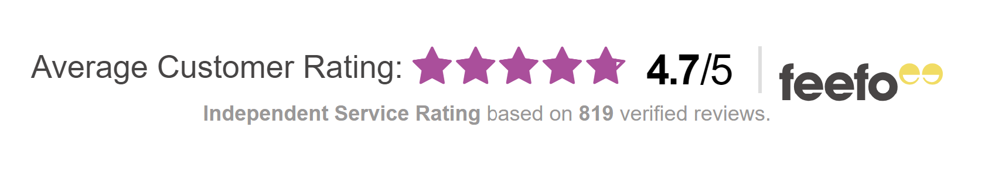
All about Ovusense
Ovusense, fertility monitoring solution, help women track their ovulation cycle.
Ovusense Flex, Ovusense advanced fertility monitor.
Ovusense Fertility monitor – Mostly used.
99% Ovulation accuracy.
Average customer rating of 4.7/5
Team Ovulife

Slide 6
Objective
Surge market share.
Increase sales geographically
Retention of customers.
Team Ovulife

Slide 7
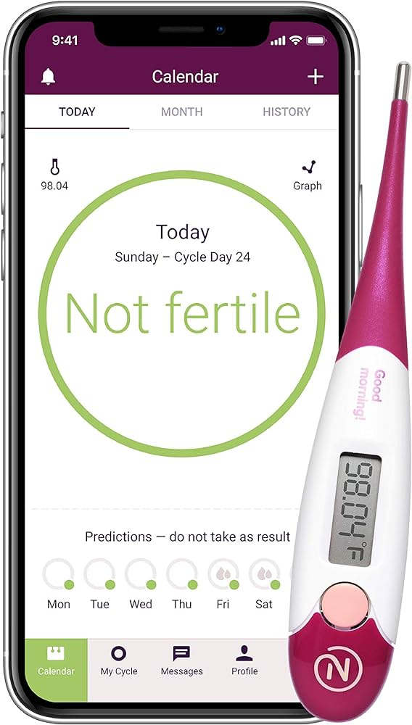
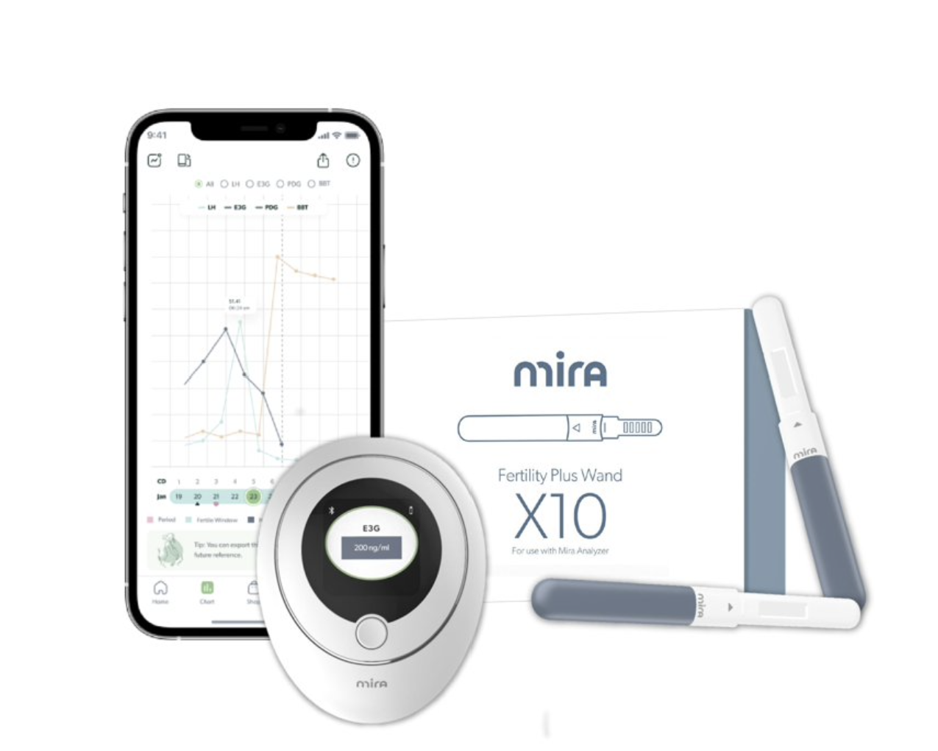
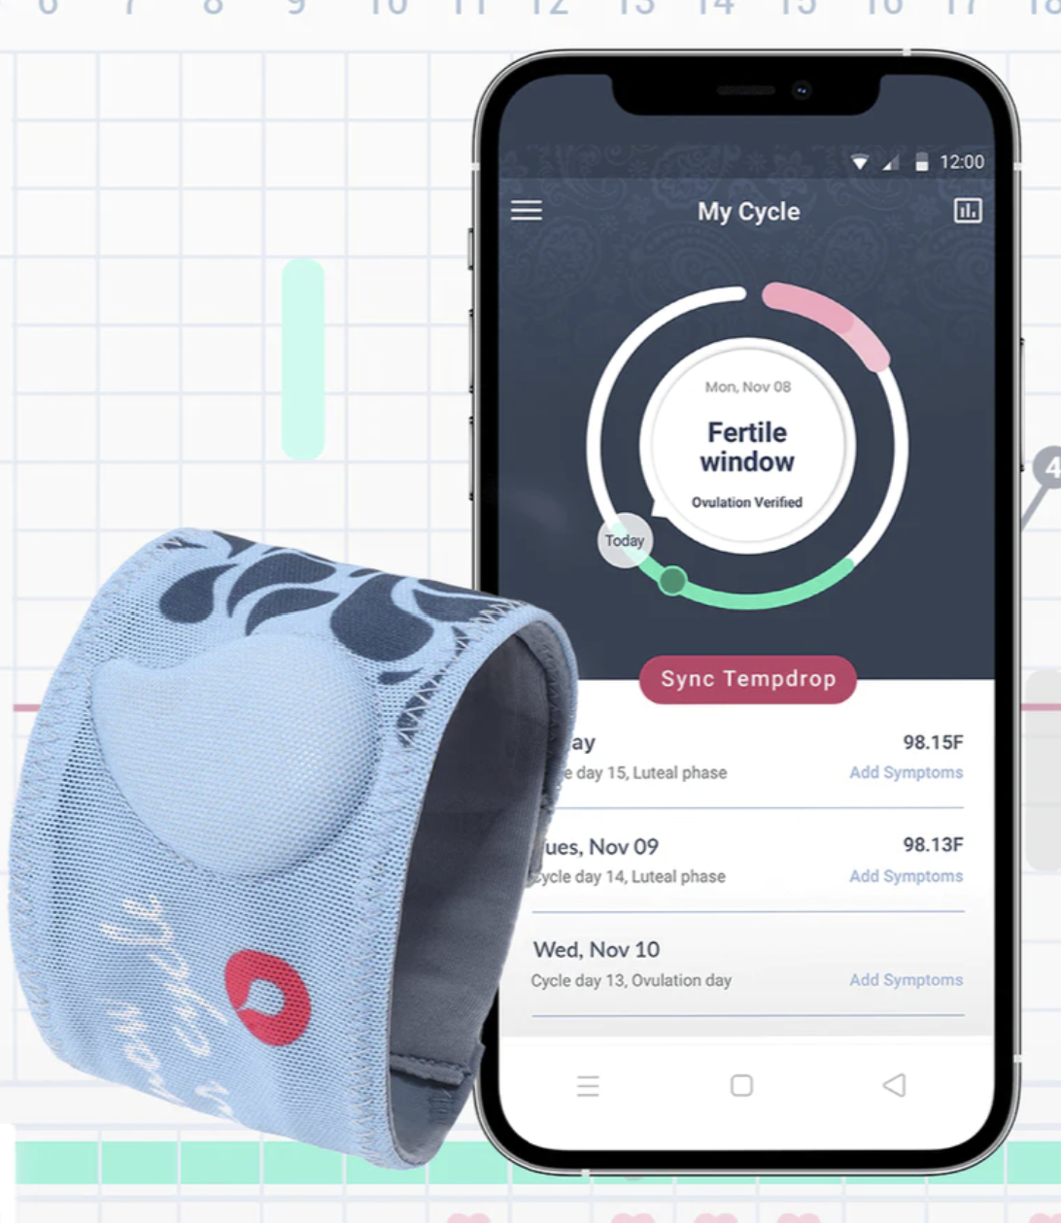
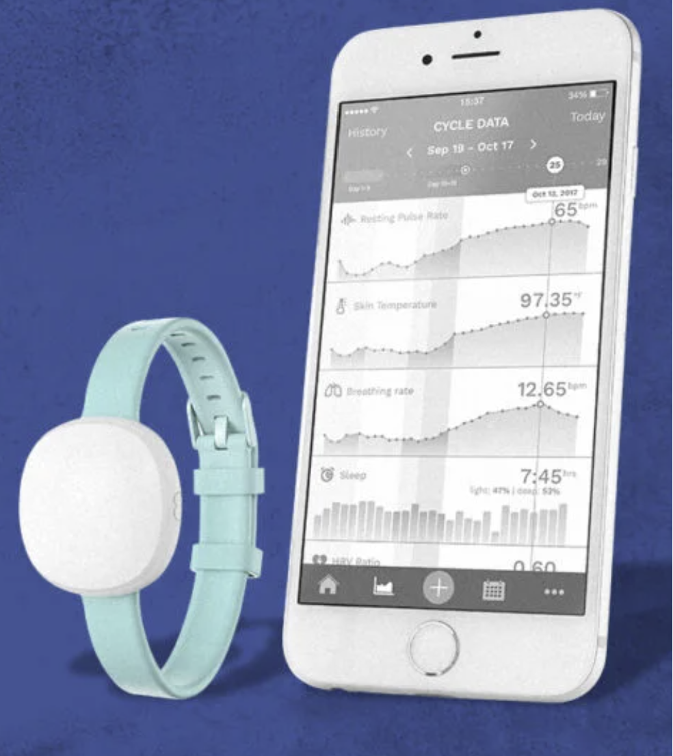
Our Contenders
Natural cycle
Mira
Tempdrop
AVA
Team Ovulife

Slide 8
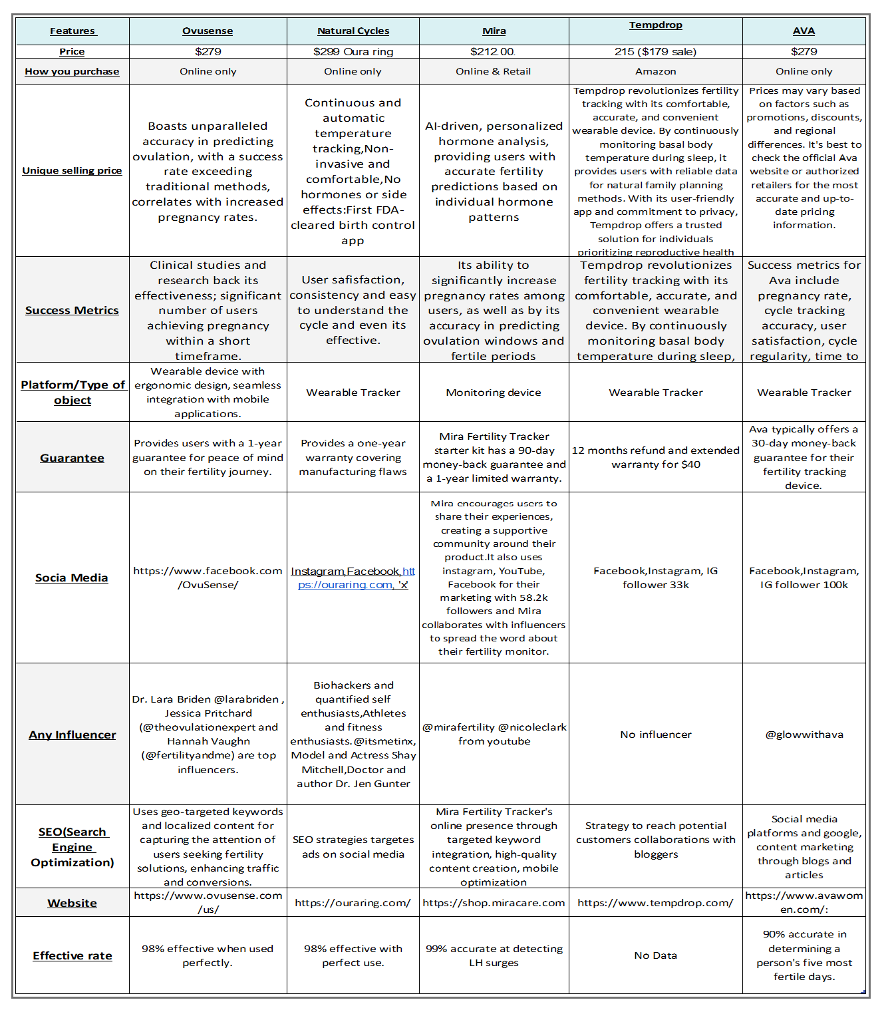
Competitive Grid
Competitive grid help us analyze Ovusense current market competitors, USP, and type of platform they used in everyday operation.
This helps us find areas of improvement.
Team Ovulife

Slide 9
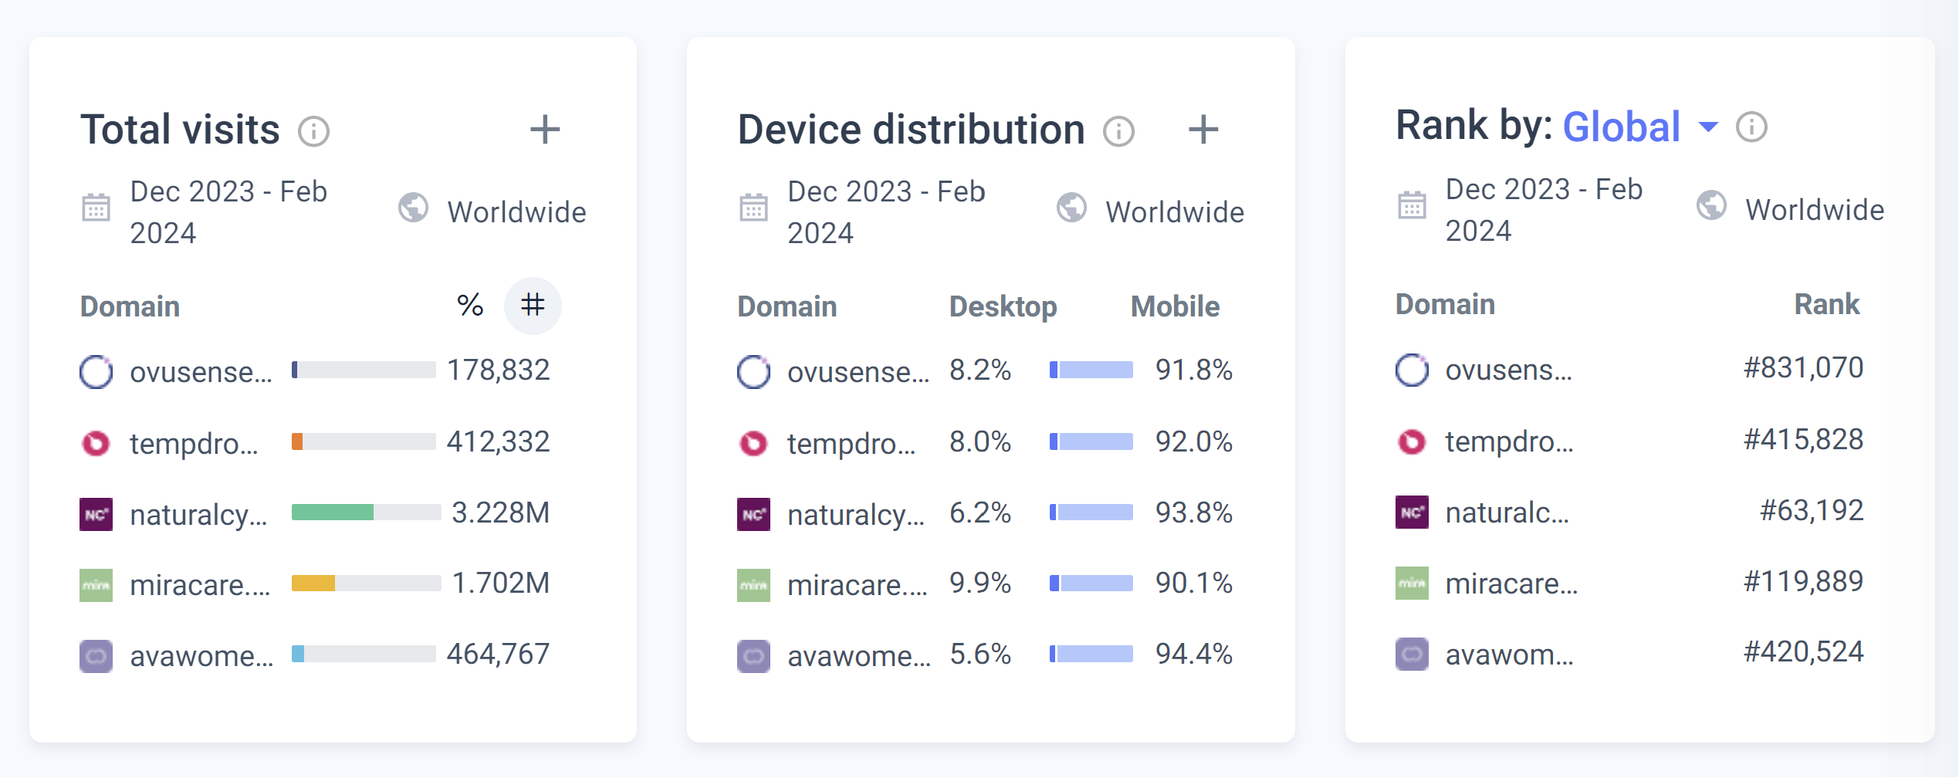
Traffic and Engagement:
Team Ovulife

Slide 10
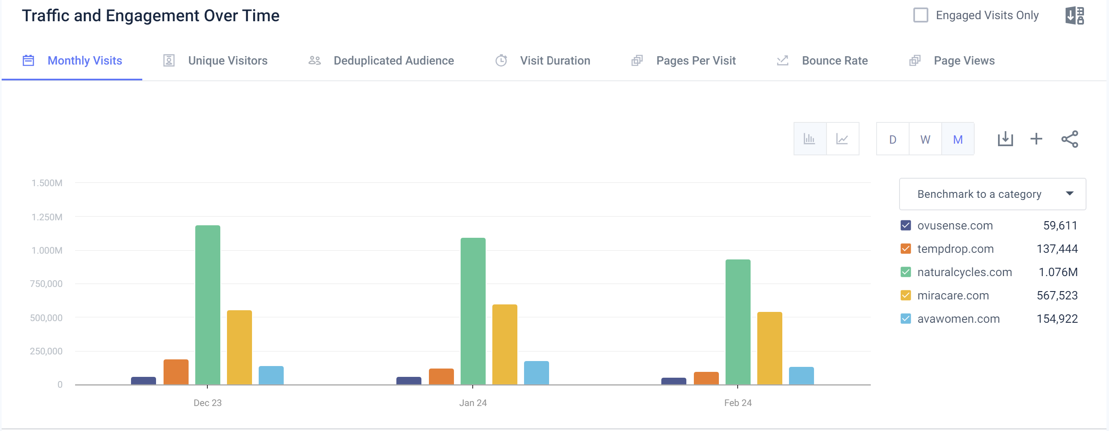
Traffic and Engagement – Monthly Visit
Team Ovulife

Slide 11
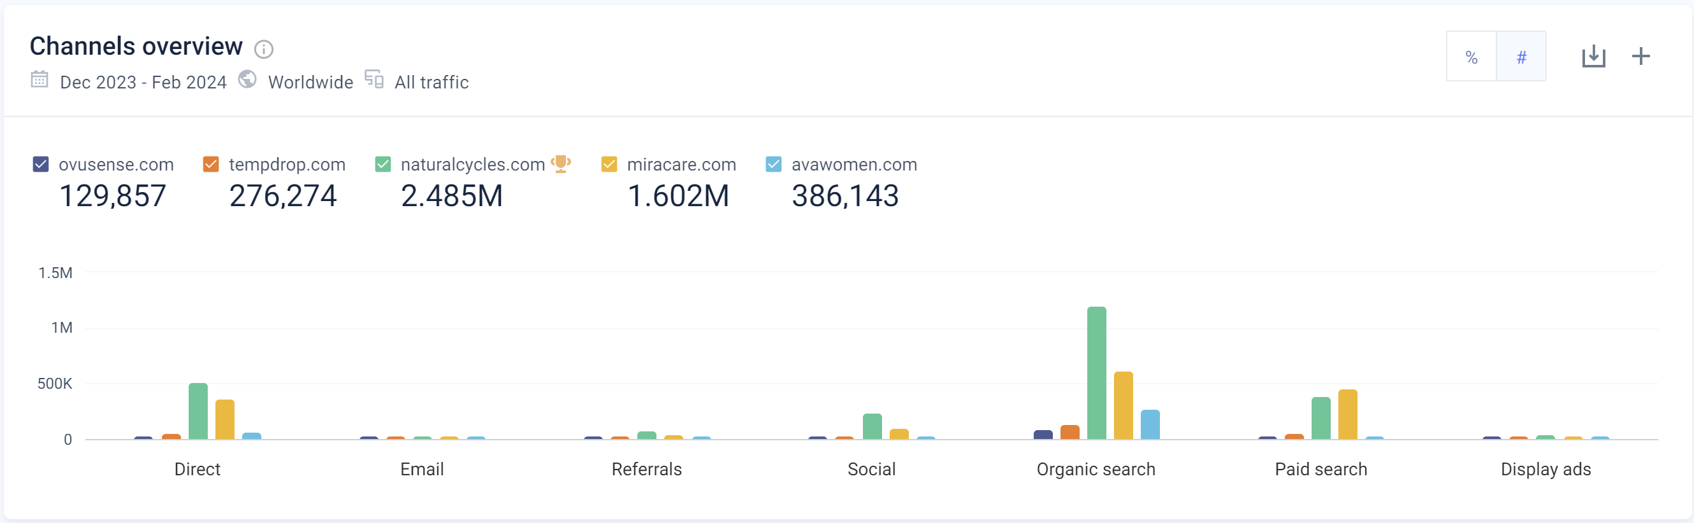
Marketing Channel
Team Ovulife

Slide 12
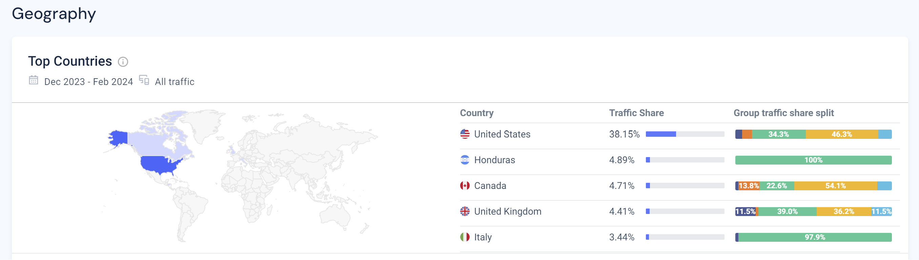
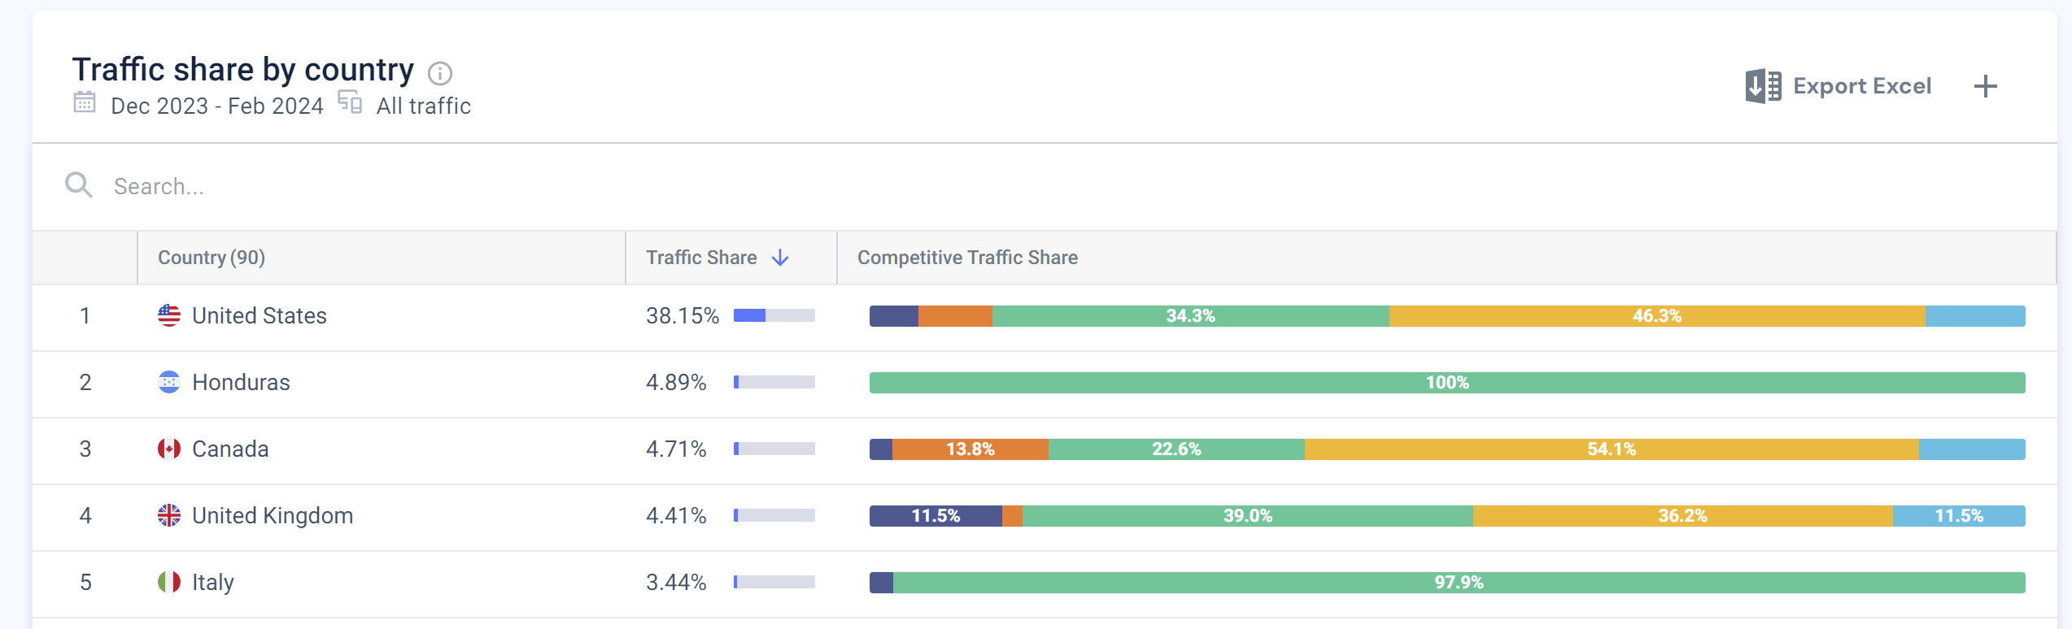
Audience – Traffic share by country
Team Ovulife

Slide 13
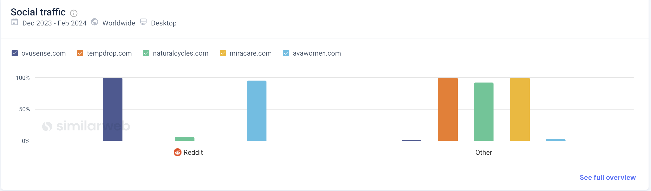
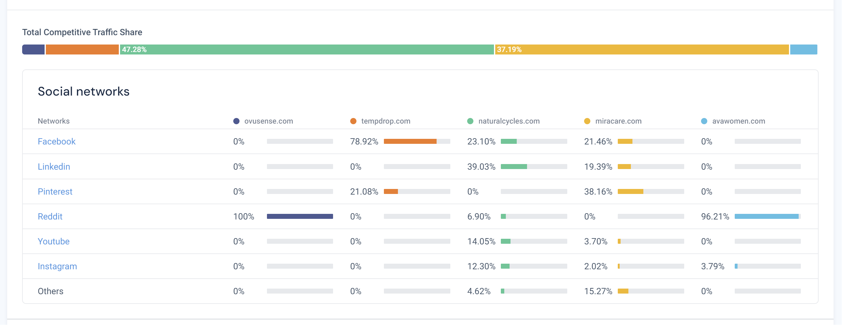
Social Traffic
Team Ovulife

Slide 14
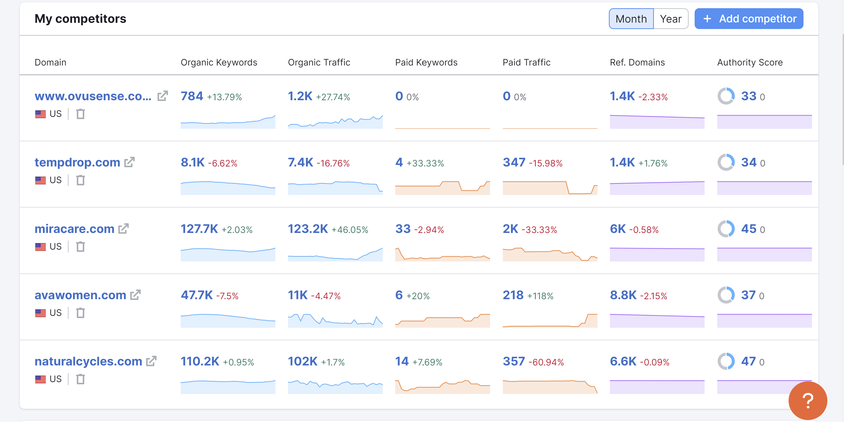
Ovusense vs competitors SEO analysis
Team Ovulife

Slide 15
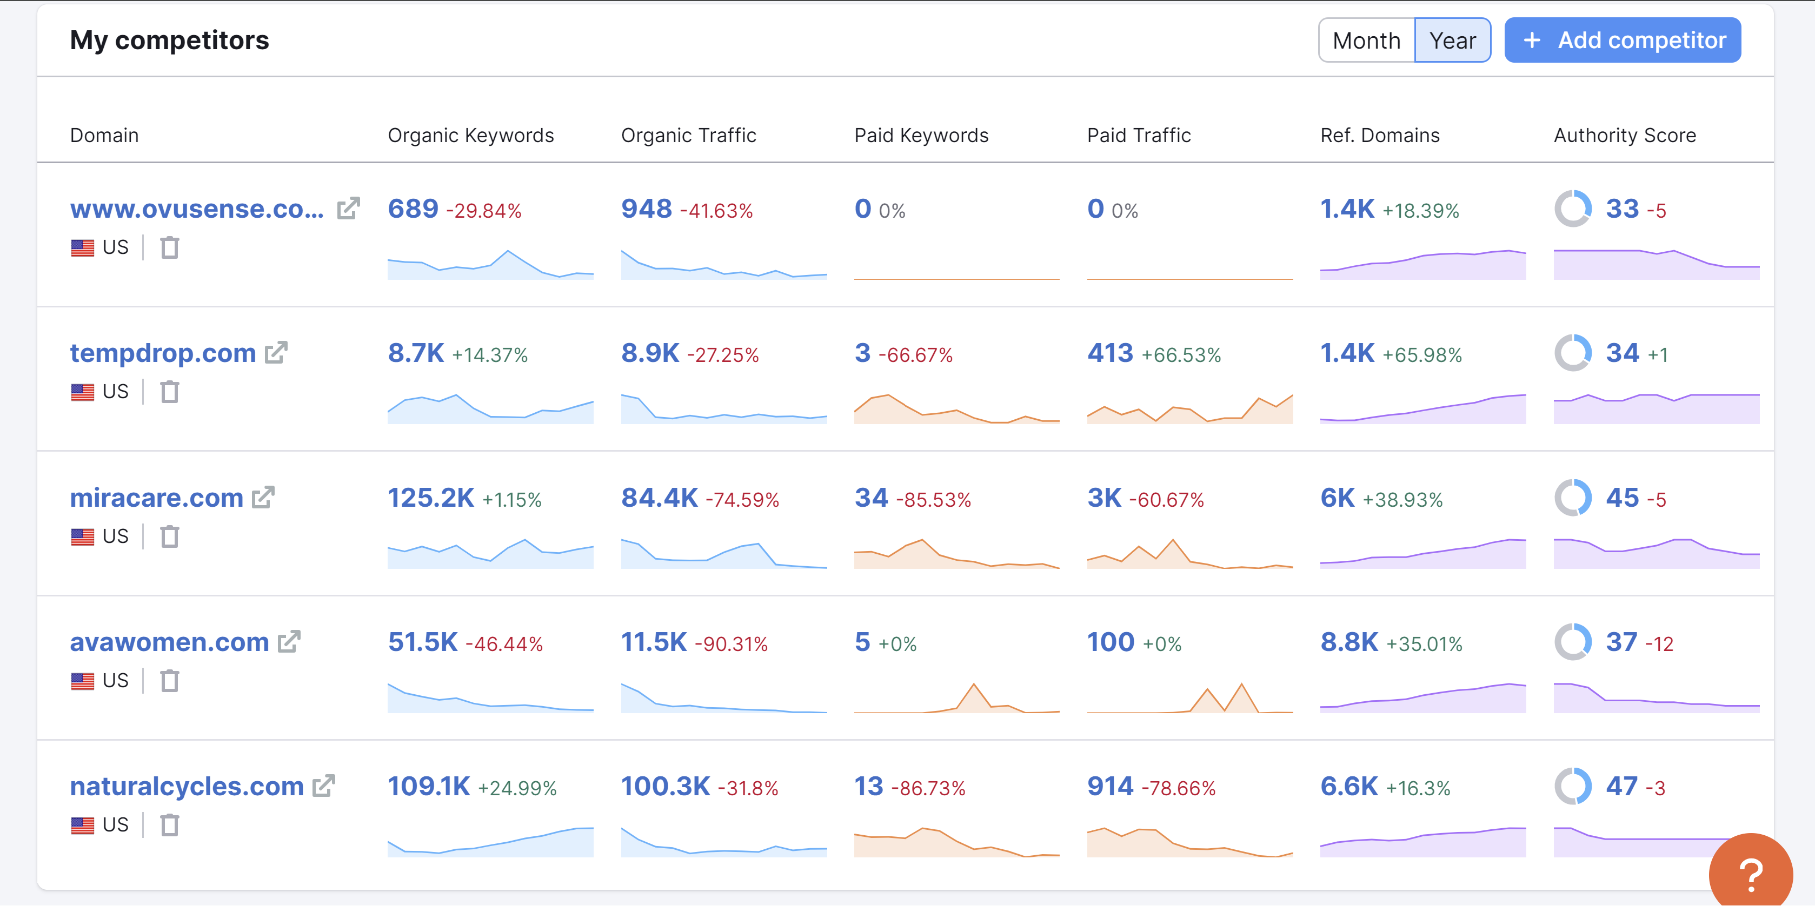
Ovusense vs competitors SEO analysis
Team Ovulife

Slide 16
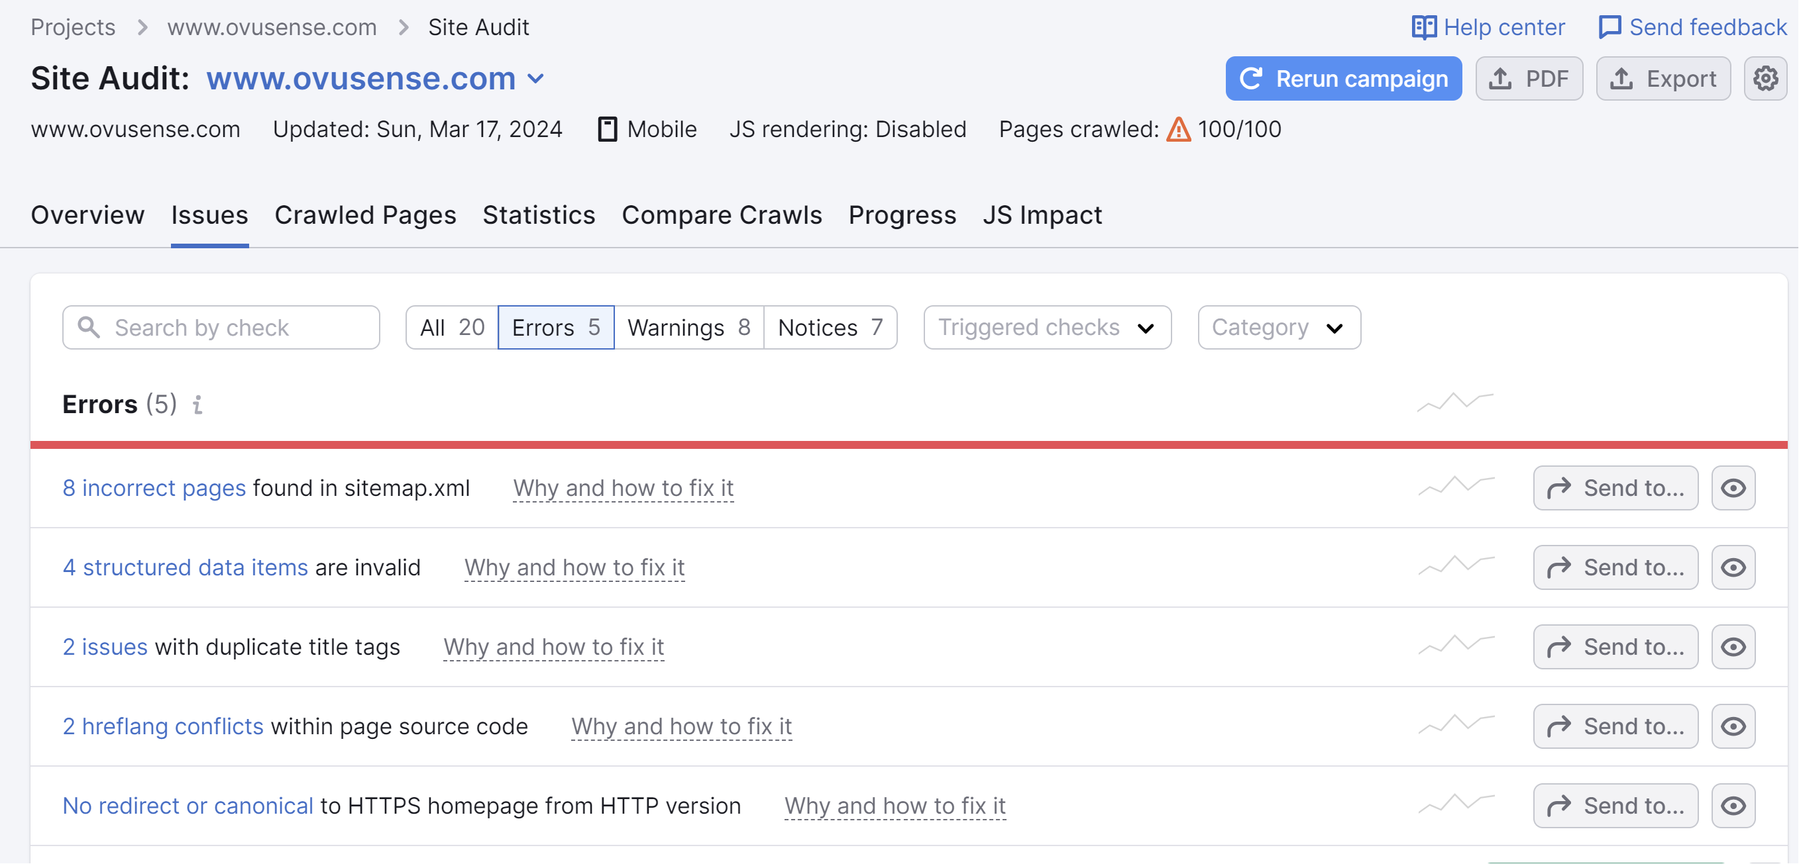
Ovusense Site Audit
Team Ovulife

Slide 17
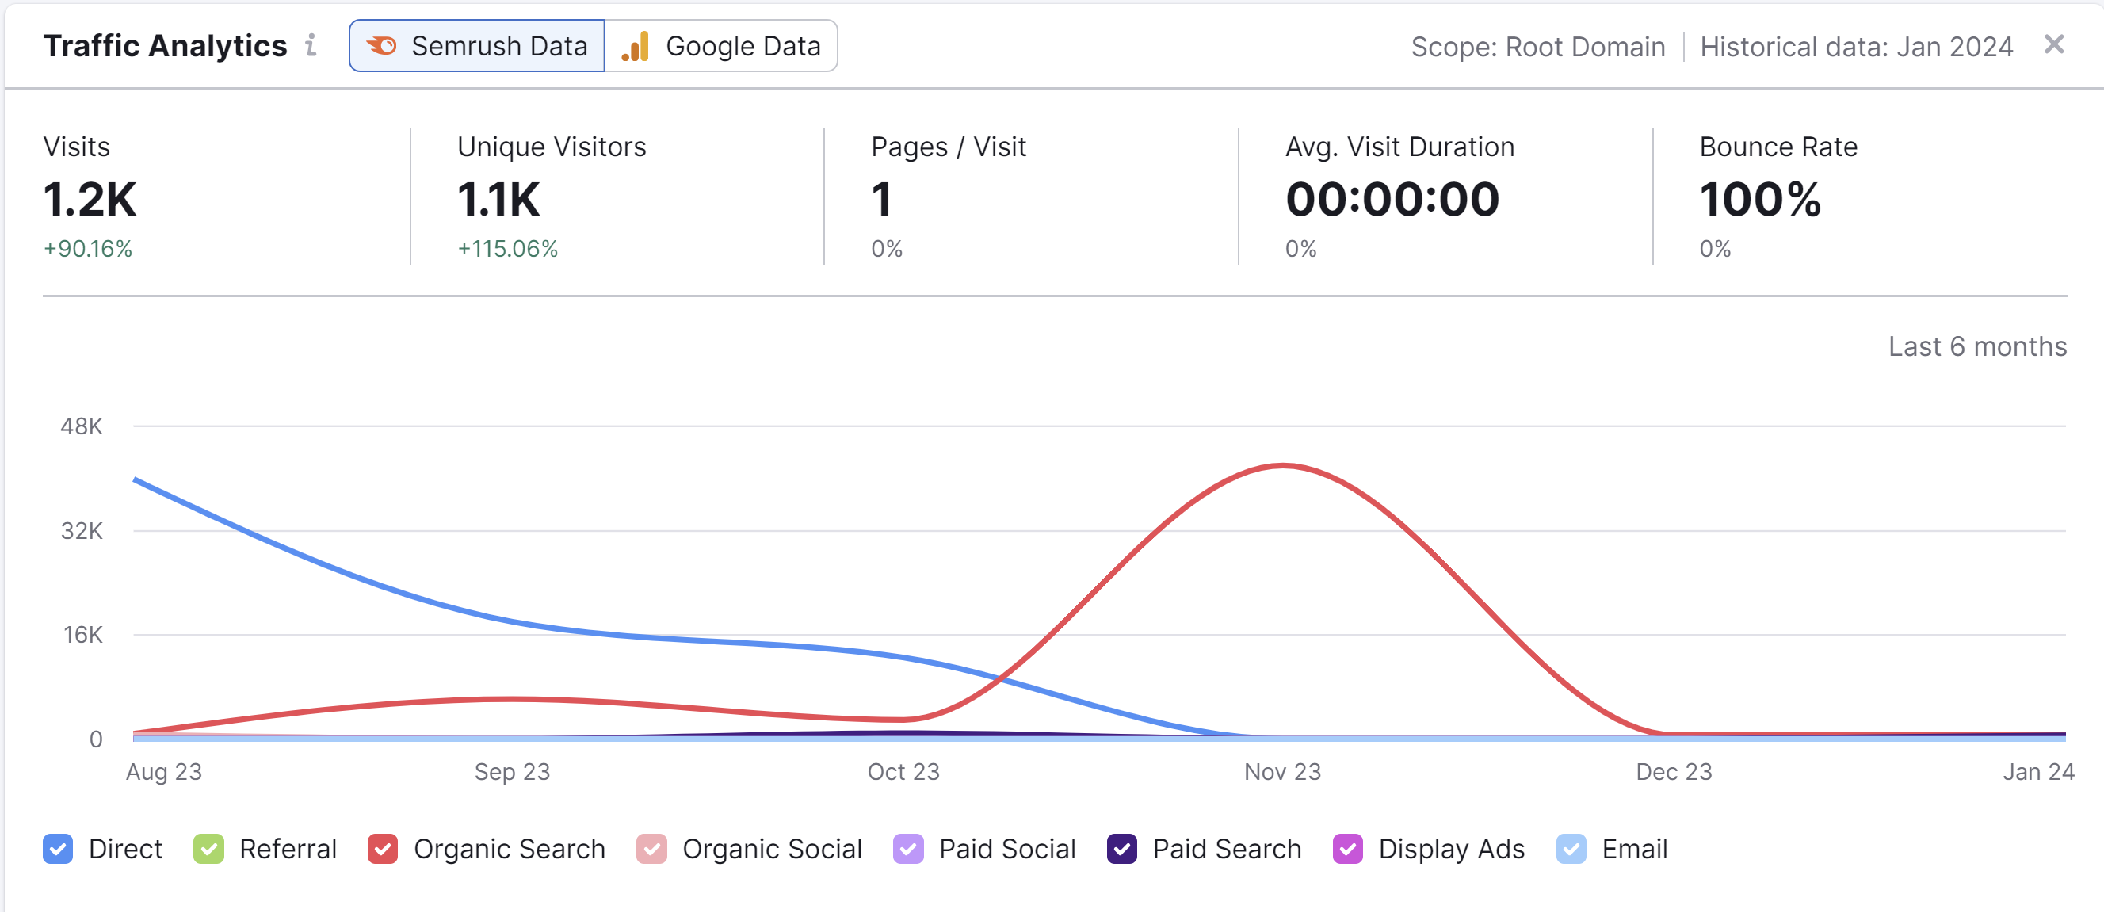
Ovusense Traffic
Team Ovulife

Slide 18
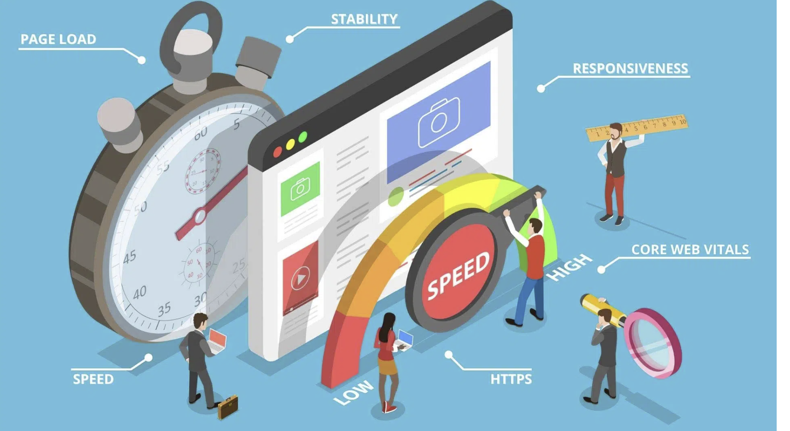
Idea 1 : Website Improvement (Free from bugs)
Simplifying the website's navigation to make it easier for users to find information about OvuSense products.
Streamline the checkout process to minimize friction and reduce cart abandonment. Implement a one-page checkout or a minimal multi-step process with clear calls-to-action, guest checkout options, and easy payment methods.
Ensuring that the OvuSense website is fully responsive and optimized for mobile devices. Many users browse and shop using smartphones and tablets, so it's crucial to provide a seamless experience across all devices and screen sizes.
Team Ovulife

Slide 19
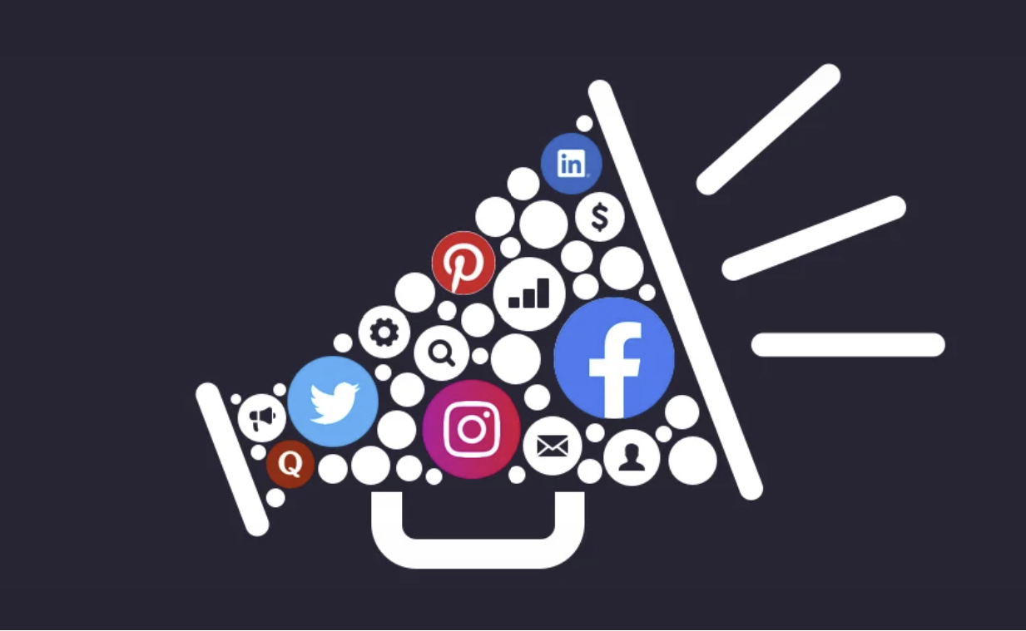
Idea 2 : Marketing Strategy or Social media campaign
Educational Content : Create and share informative content about fertility health, ovulation tracking, and the benefits of using OvuSense. This could include blog posts, articles, videos, and infographics that address common questions and concerns related to fertility.
Influencer Partnership: Collaborate with influencers in the fertility and women's health space to promote OvuSense to their followers. Identify influencers who resonate with your target audience and have a genuine interest in promoting the product.
Contests and Giveaways: Organize contests or giveaways on social media to increase engagement and attract new followers. Offer OvuSense devices or related fertility products as prizes and encourage users to participate by liking, sharing, or commenting on your posts.
Team Ovulife
Notes:
2. Success Stories and Testimonials: Share real-life success stories and testimonials from OvuSense users who have successfully conceived with the help of the product. Personal narratives can resonate with individuals facing similar challenges and inspire confidence in OvuSense as a reliable solution.
Blog Posts and Articles : Develop blog posts, infographics, and videos explaining the importance of accurate ovulation tracking for conception. Content should highlight the benefits of OvuSense over traditional methods like ovulation predictor kits (OPKs) and fertility apps.
3. Email Marketing:
4. Social Media Advertising: Run targeted ads on platforms like Facebook, Instagram, and Pinterest, focusing on women within the specified age range and with interests related to fertility, pregnancy, and motherhood.
5. Instagram Giveaways: Host monthly giveaways on Instagram where followers can win OvuSense starter kits or other fertility-related prizes. Encourage participants to like, share, and tag friends to increase visibility and engagement.

Slide 20

Idea 3 : Paid Traffic
Video Ads: Create video advertisements showcasing the features and benefits of OvuSense and distribute them through paid placements on platforms like YouTube or through social media advertising. Video ads can be engaging and effective in capturing users' attention and driving conversions.
Influencer Marketing: Collaborate with influencers or content creators in the fertility and women's health space to promote OvuSense through sponsored content or paid partnerships. Influencer marketing can help reach a targeted audience and build credibility through authentic endorsements.
Retargeting Ads: Implement retargeting campaigns to re-engage users who have visited the OvuSense website but did not make a purchase. Retargeting ads can remind users of the product, offer incentives to complete their purchase, or provide additional information to address any concerns they may have.
Team Ovulife
Notes:
interesting videos showing how OvuSense helps couples get pregnant. Use real stories and keep it under a minute. Share these videos on social media sites like Facebook, Instagram, and YouTube, focusing on people interested in having a baby. Test different versions of the videos to see what works best, and spend money wisely to reach more people.
Influencer marketing involves partnering with well-known INFLUENCERS in the fertility and women's health space to promote OvuSense. They'll share their experiences with their followers, helping to raise awareness and interest in the product.
Retargeting ads show personalized reminders to website visitors who haven't bought yet, using cookies to track their online activity. These ads appear on other sites they visit, prompting them to reconsider purchasing OvuSense by highlighting its benefits. It boosts conversion rates by targeting interested users.

Slide 21

Idea 4 : Escalate Traffic in other countries
Targeted Advertising : Invest in targeted advertising campaigns on platforms popular in each target country, such as local search engines, social media networks, and online marketplaces. Use demographic targeting options to reach users based on their location, language, interests, and behavior.
Localized Social Media Presence: Create and maintain active profiles on social media platforms popular in each target country. Share localized content, engage with users in their native language, and participate in relevant conversations to build brand awareness and foster connections with the local audience.
Monitor and Analyze Performance: Continuously monitor website traffic, user behavior, and conversion metrics in each target country to track the effectiveness of your efforts. Use web analytics tools to gain insights into which strategies are driving traffic and engagement, and adjust your tactics accordingly to optimize performance over time.
Team Ovulife

Slide 22
Idea 5 : Make it visible
Distribution channel: Expand OvuSense distribution channel by partnering with retailers, pharmacies, Health and wellness boutique to stock product on shelves.
a) Increase Visibility
b) Accessibility for customers who prefer to purchase in-person rather online.
OvuSense, List products on popular online market place such as Amazon, Etsy and Ebay.
Expose to larger audience.
Trade shows and Events: Setting up a booth or exhibition stand at relevant trade shows and events related to fertility, women's health, or medical technology.
a)OvuSense products, features infographics demonstrations, and provides informational materials.
Team Ovulife

Slide 23
References
https://pro.similarweb.com/#/digitalsuite/home
https://www.semrush.com/projects/
https://www.ovusense.com/us/advanced-fertility-monitor/
https://www.tempdrop.com/
https://www.miracare.com/
https://www.avawomen.com/
https://www.naturalcycles.com/
Team Ovulife

Slide 24

Team Ovulife

